Slide 1
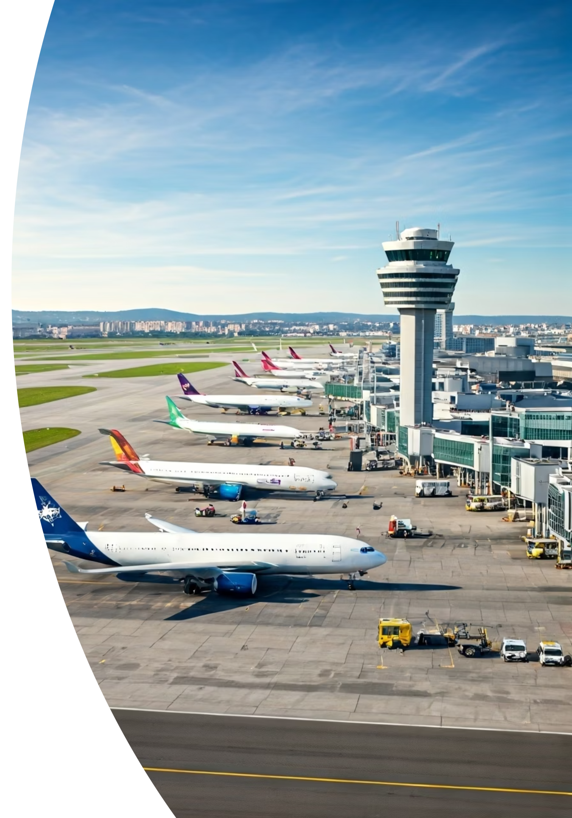
Flight Management System
PRESENTED BY
AREESHA RAHEEL(55039)
KAINAT NAUMAN(55115)

Slide 2
Introduction to Flight Management System
Streamlines and automates flight booking.
Manages passengers, tickets, and feedback efficiently.
Handles flights, airports, airlines, and luggage.
Enhances efficiency across all aviation processes.
Supports over 1500 daily flights effectively.
.

Slide 3
Why a Database for Flight Systems?
Centralized Data
Data Integrity
A single, reliable source for all flight information.
Ensures consistent and accurate records for bookings.
Scalability
Efficiency
Supports growth to 100,000+ daily transactions.
Enables sub-second data retrieval for real-time updates.
Security
Analytics
Protects sensitive passenger and operational data.
Drives revenue and operational optimization insights.
.

Slide 4






Key Modules & Functionalities
Passenger Management
Reservation & Ticketing
Profiles, loyalty tiers, contact details, special needs.
Booking, cancellation, seat selection, secure payment processing.
Flight Operations
Baggage Handling
Schedules, gate assignments, crew rostering, flight status.
Real-time tracking, weight limits, automated claims processing.
Employee Management
Reporting & Analytics
Roles, permissions, performance tracking, shift scheduling.
Operational insights, financial summaries, trend analysis.
.

Slide 5
Database Schema Overview
Core Entities
Operational Data
Passengers, Flights, Airports, Airlines.
Employees, Aircrafts, defined Routes.
Foundation of the entire system.
Supports daily aviation processes.
Transactional Data
Relationships
Bookings, Tickets, Luggage details.
Defines connections (e.g., Flight-to-Booking).
Records every customer interaction.
Ensures ACID compliance and referential integrity.
.

Slide 6
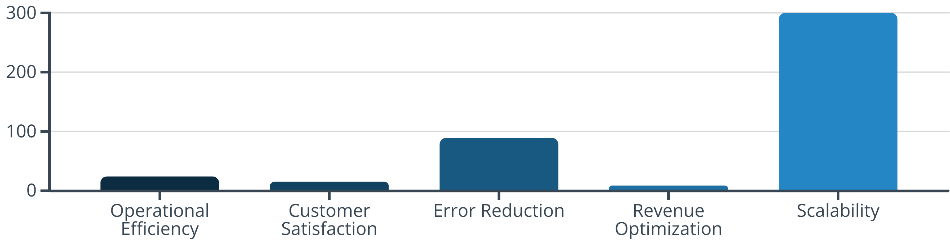
Benefits & Impact
The FMS delivers significant improvements across key areas. Operational efficiency sees a 25% boost, while customer satisfaction increases by 15%. Manual booking errors are reduced by an impressive 90%, and revenue is optimized by 10% through dynamic pricing. The system also offers robust scalability, supporting triple passenger volume growth.
.

Slide 7

Conclusion
The FMS database is fundamental for modern aviation.
It provides a robust, scalable, and secure data platform.
Demonstrates practical database design and implementation.
Automates airline processes with SQL and reporting tools.
Supports effective management and enhances customer service.
.
.
.
.

